Slide 1


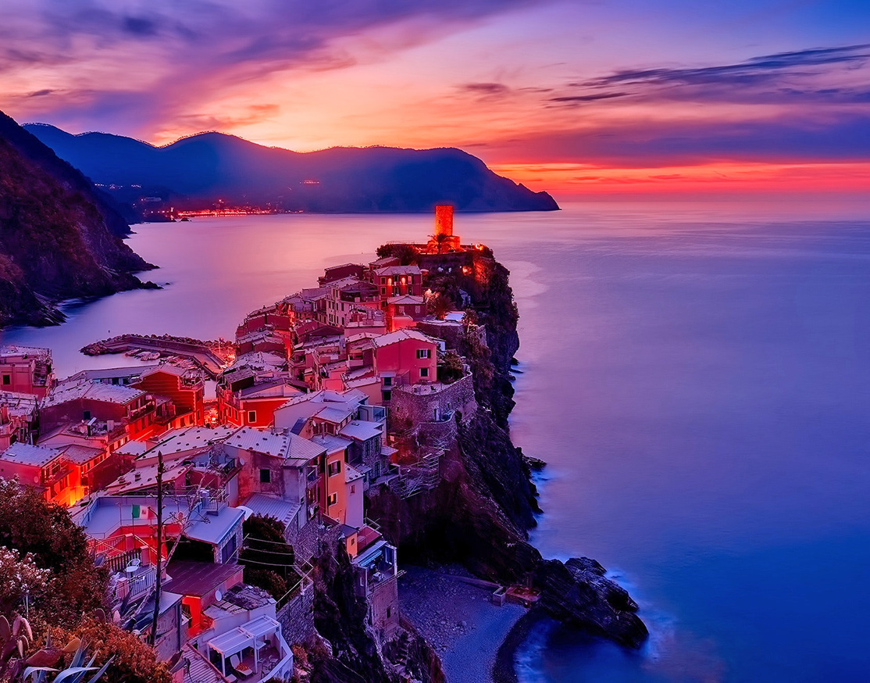
F.L.FLOWER
Group members: Romisa Manafi – Sara Sedighi – Aysan Bagheri – Parastoo kolahdouzan
Coordinator: Parastoo kolahdouzan
Orang 1401
TA: M. Abedi

Slide 2
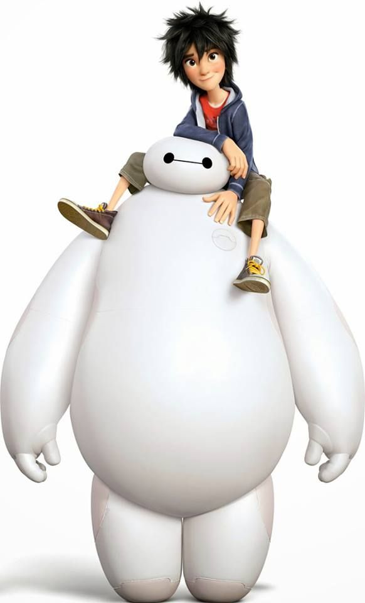
What is our project?
What did they do in international project class?
Who is a hero?
Who is our hero in this project?

Slide 3
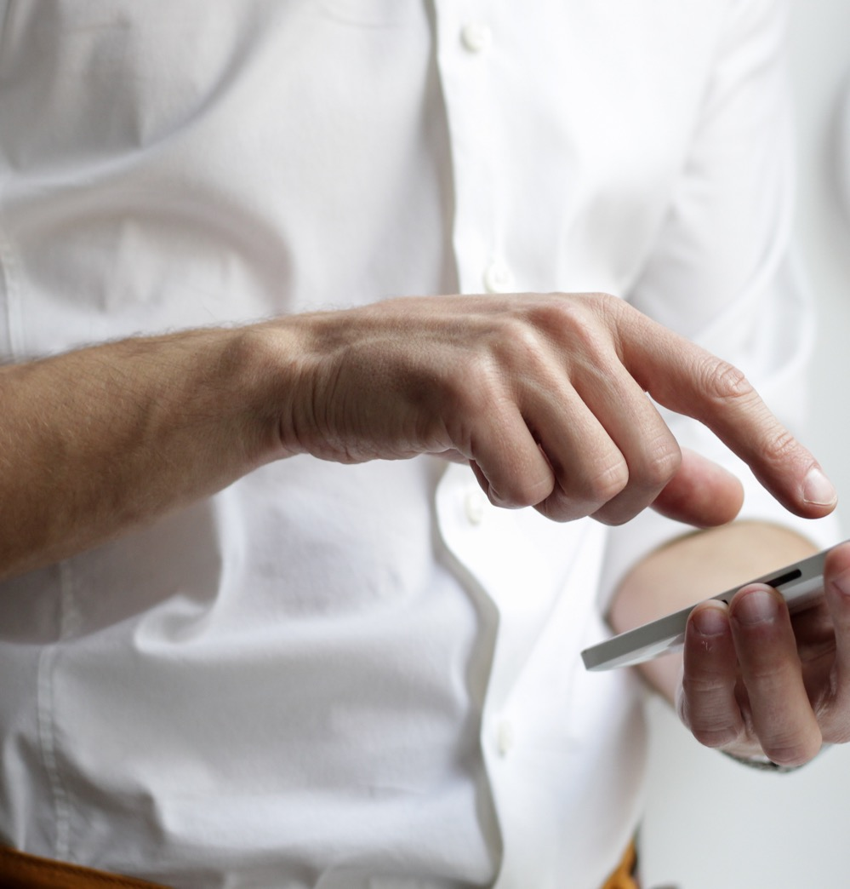
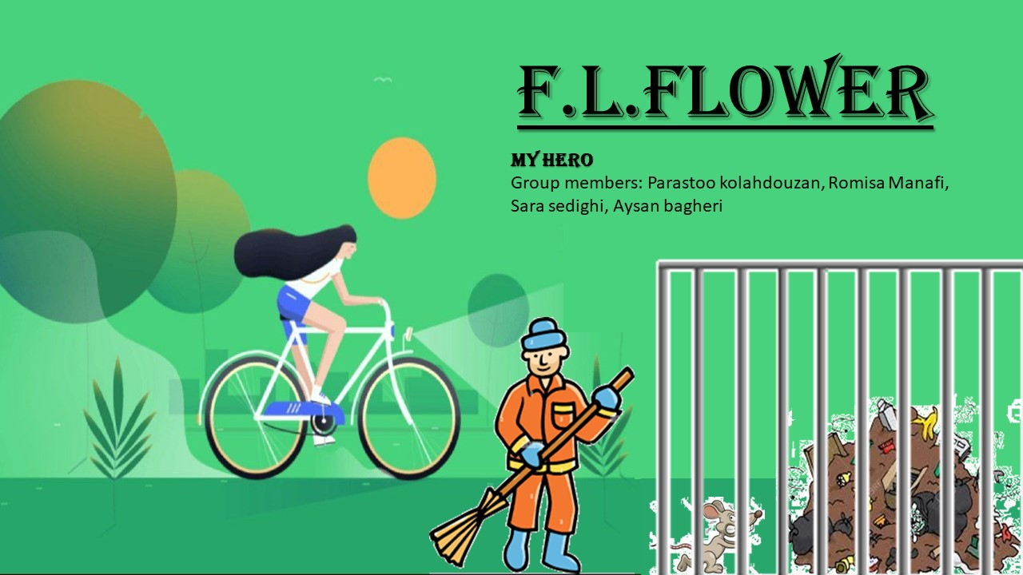
Our poster
We designed our poster and our hero is a sweeper

Slide 4

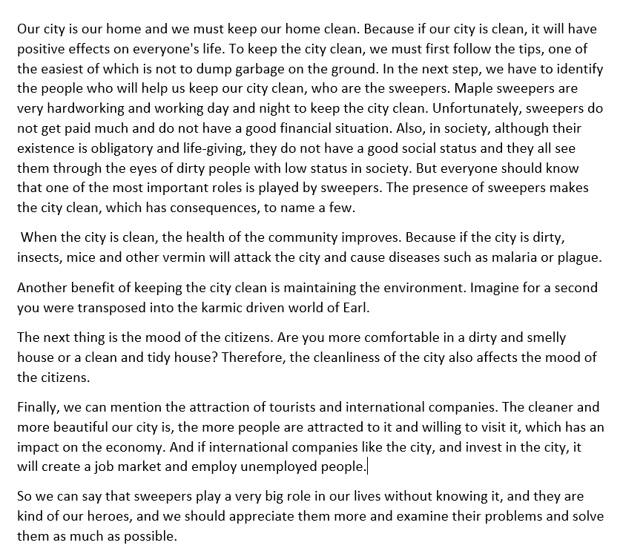
Our story
We wrote a story in Persian then we translate it to English and its 365 words

Slide 5

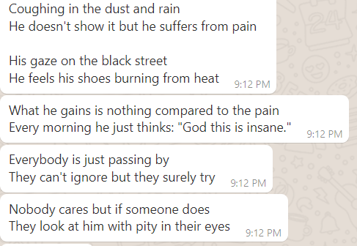
Our song
We wrote our lyrics of our song
song with out words: Nocturne -

Slide 6
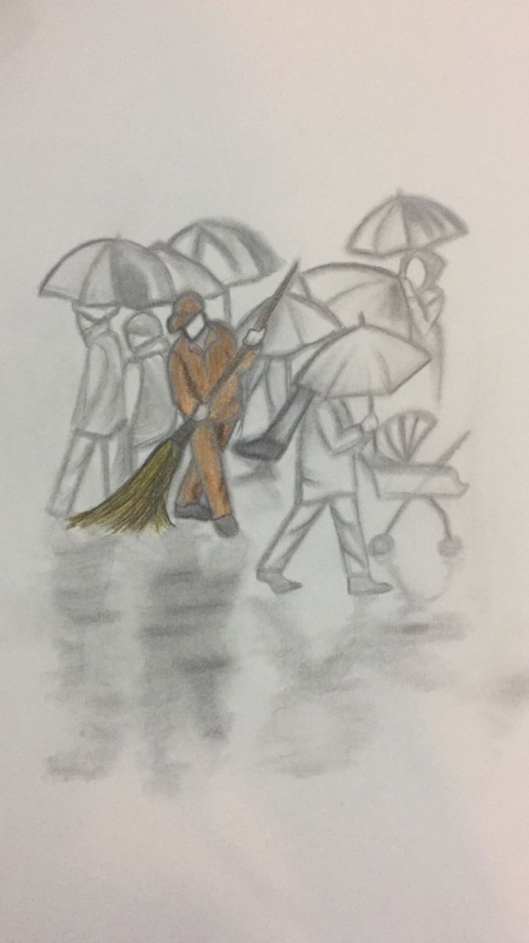
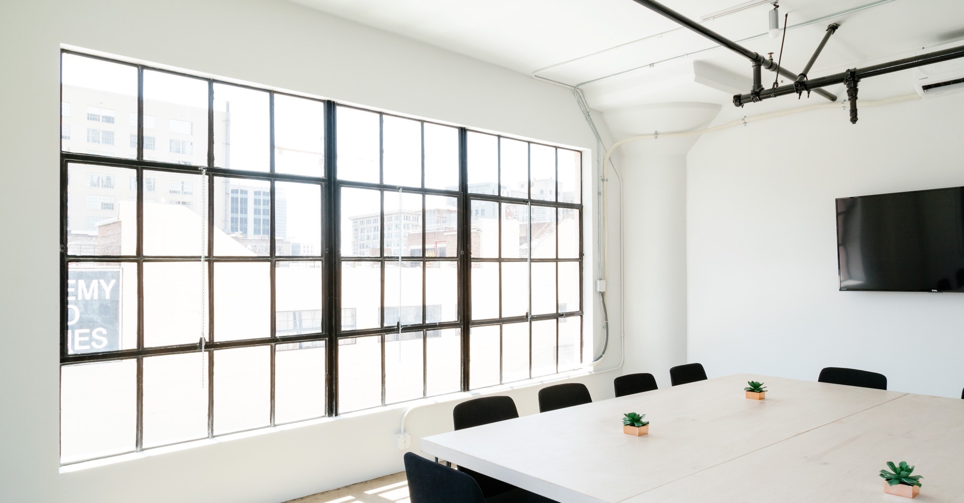
Large image
Our painting

Slide 7
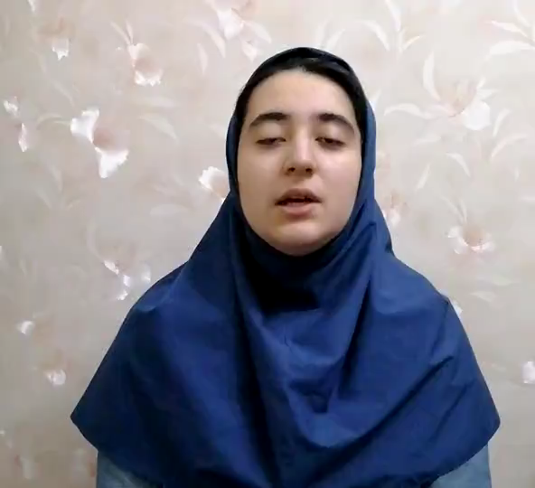
Watching a film for better understanding:

Slide 8
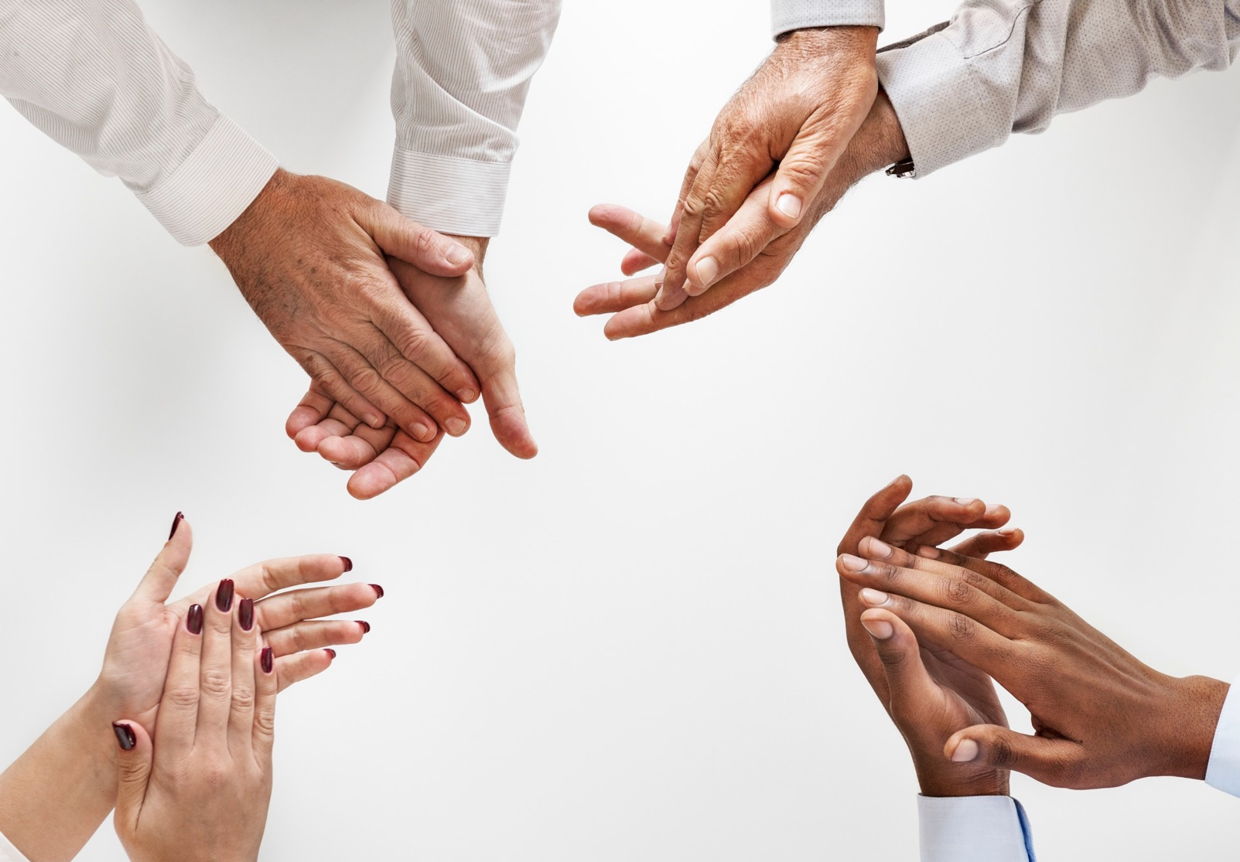
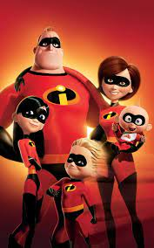




Thanks for you attention☺
My hero
F.L.FLOWER
Mrs. Abedi
Farzanegan 5

